Slide 1
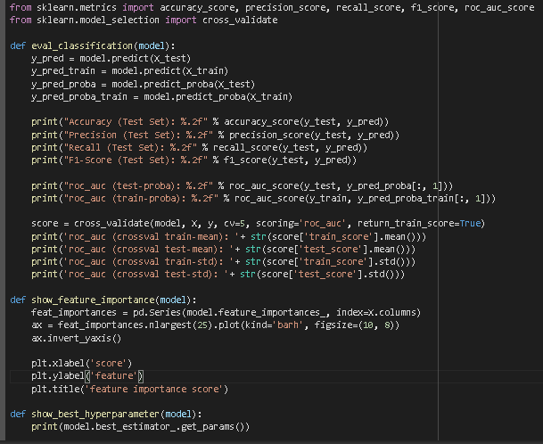
Data Modeling
Modeling the train data using 5 machine learning algorithms and evaluating the results of accuracy, precision, recall, f1, and AUC.
For more details, see jupyter notebook here

Slide 2
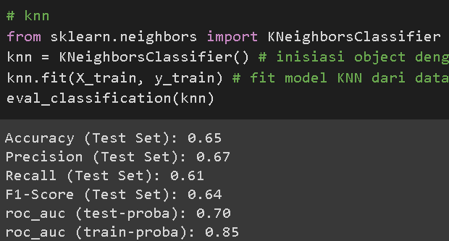
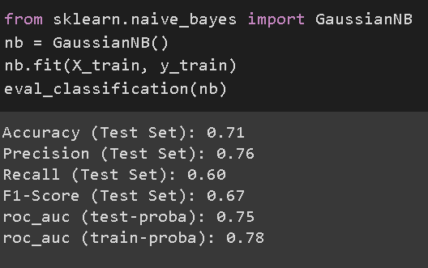
Data Modeling
From the modeling results, it can be seen that models using the KNN and GaussianNB algorithms tend to have low score. While the Tree Based (XGB, random forest, decision tree) model tends to have higher score.
For more details, see jupyter notebook here

Slide 3
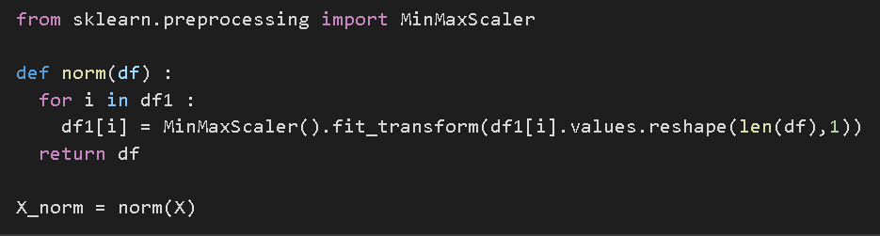
Data Modeling
Then normalization of train and test data is carried out in the hope that it can produce a better confusion matrix output.
For more details, see jupyter notebook here

Slide 4
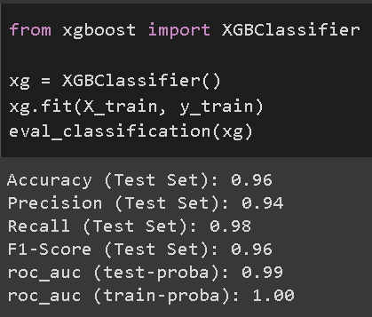
Data Modeling
After normalization, the evaluation metric tends to be slightly better. Of all the models that have been tried, the XGBClassifier model (XGBoost) is used as the best-fit model.
For more details, see jupyter notebook here

Slide 5
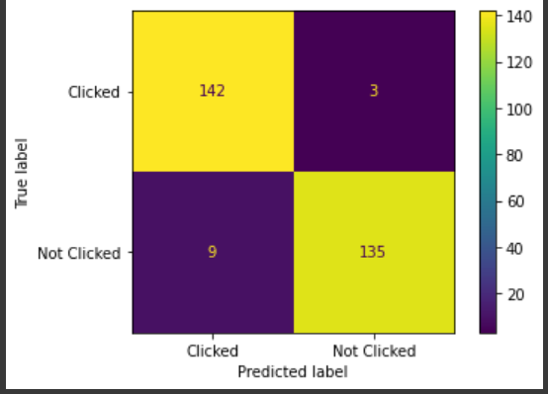
Data Modeling
The confusion matrix results using the XGBClassifier model on the side show good performance, with 9 false positives and 3 false negatives from the model, this number is fairly small when compared to the amount of test data used.
For more details, see jupyter notebook here

Slide 6
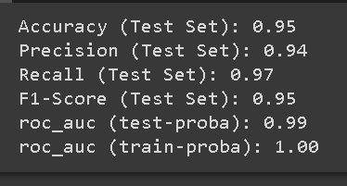
Data Modeling
After hyperparameter tuning, the performance of the model becomes lower, so we will use the model before applied hyperparameter tuning.
For more details, see jupyter notebook here

Slide 7
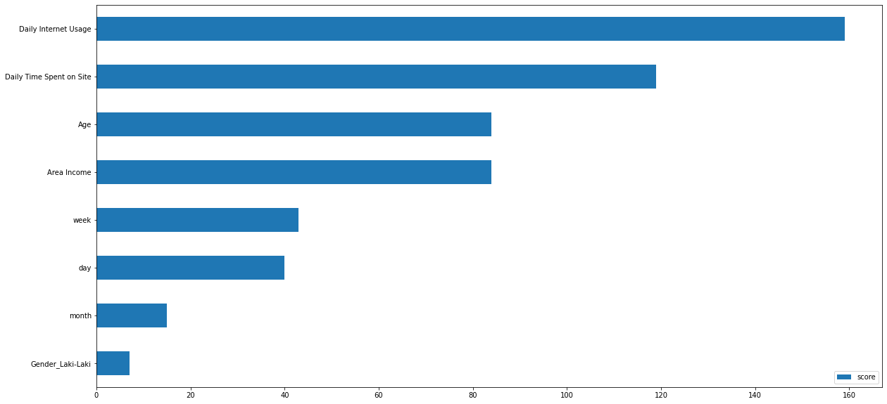
Data Modeling
The 4 most influential features in this machine learning model are daily internet usage, daily time spent on site, area income, and age.
For more details, see jupyter notebook here

